Slide 1
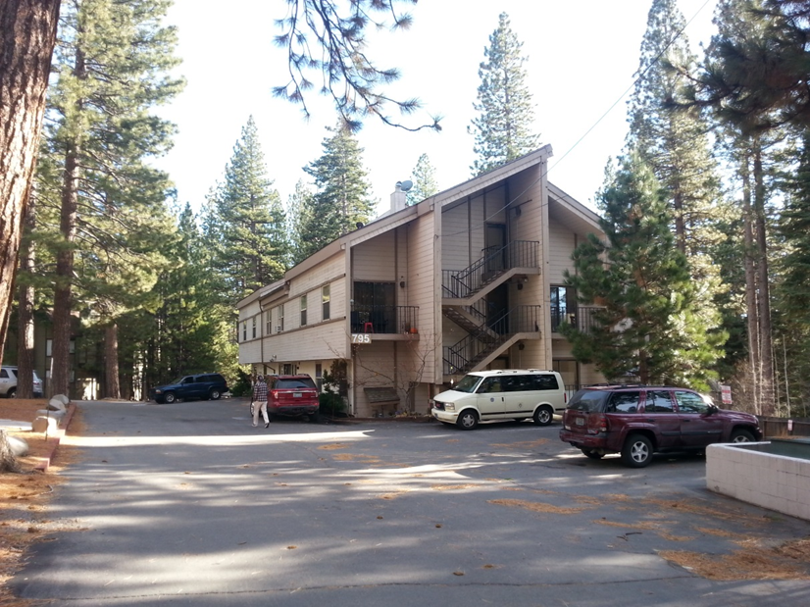
Washoe County Board of Adjustment
June 6, 2019
Administrative Permit Case Number WADMIN19-0008 Carlson and Associates
(Mays Building)

Slide 2
Case Description
For possible action, hearing, and discussion to approve an administrative permit to allow the conversion of a portion of the first floor of an existing commercial office building into four residential apartments. The first floor of the building is 3662 square feet in size, approximately 600 square feet is proposed to remain as a commercial office and approximately 3000 square feet is proposed to be converted into residential space.

Slide 3
Case History
This project was previously approved in February of 2017.
That approval expired prior to submission of complete building plans.

Slide 4
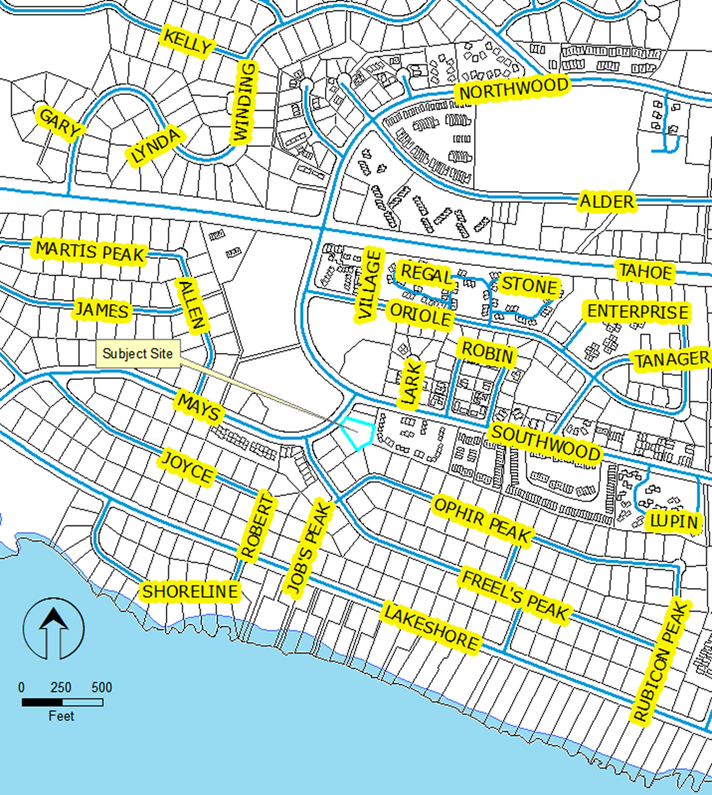
Vicinity
Map

Slide 5
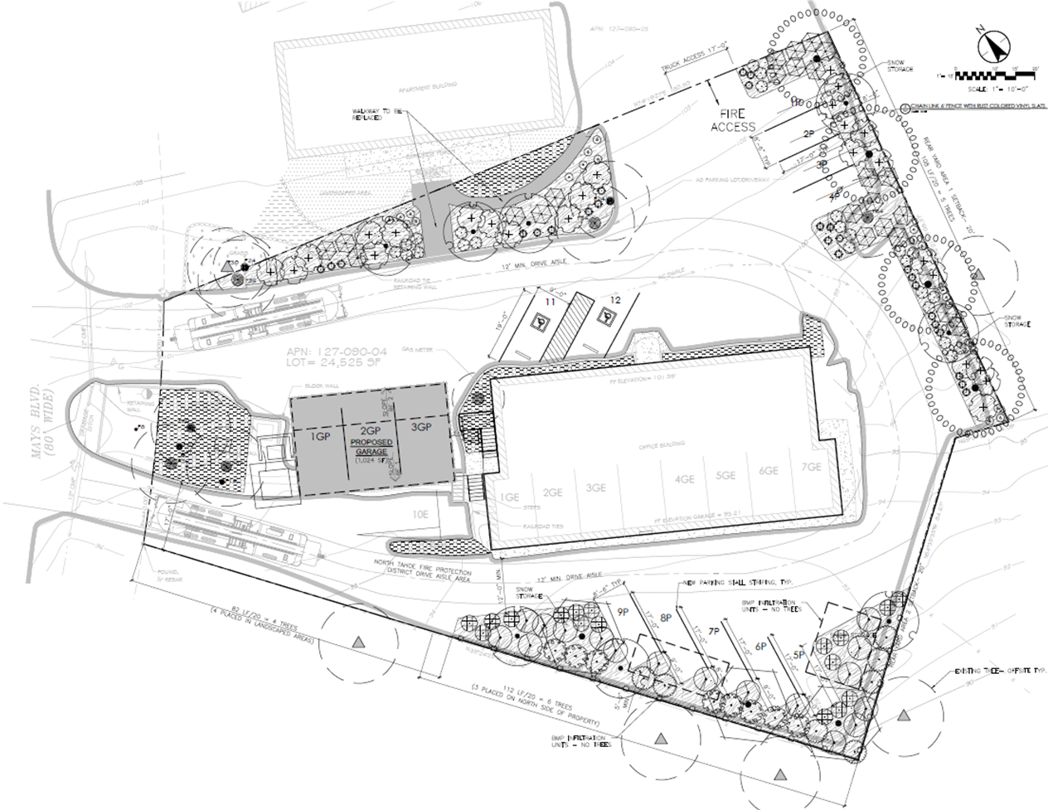
Site Plan

Slide 6
Analysis
Zoned MDU (11 dwellings allowed, 10 proposed)
Exterior of building will not be modified
Surrounded by residential uses
Current Code must be met
  Lighting
  Landscaping
  Buffering
  Parking

Slide 7
Analysis
Landscaping has been modified by Director to provide for Fire access.

Slide 8
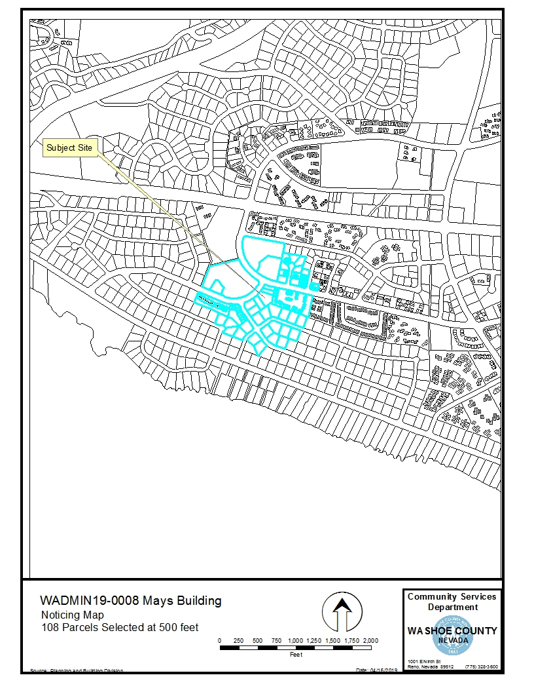
Public
Notice

Slide 9
Conditions of Approval
Standard conditions, generally relating to meeting current Development Code requirements.
Plans must be submitted within one year.
Plans must be issued within two years.

Slide 10
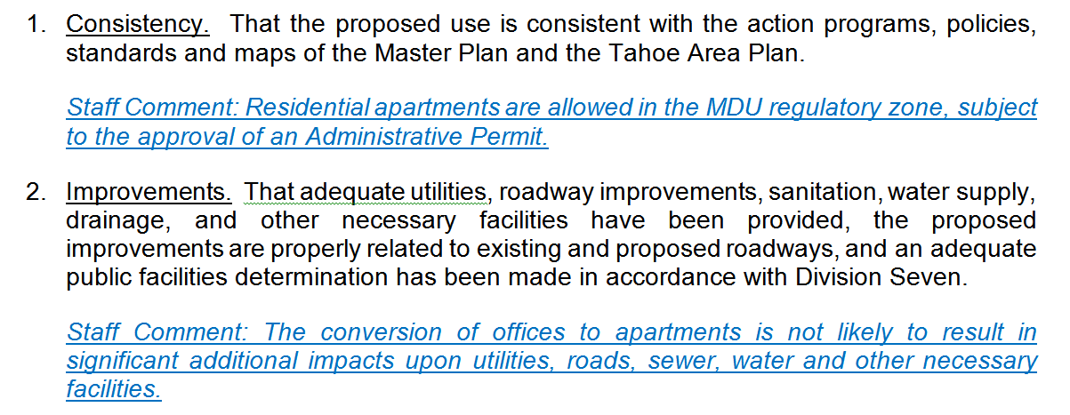
Administrative Permit Findings

Slide 11
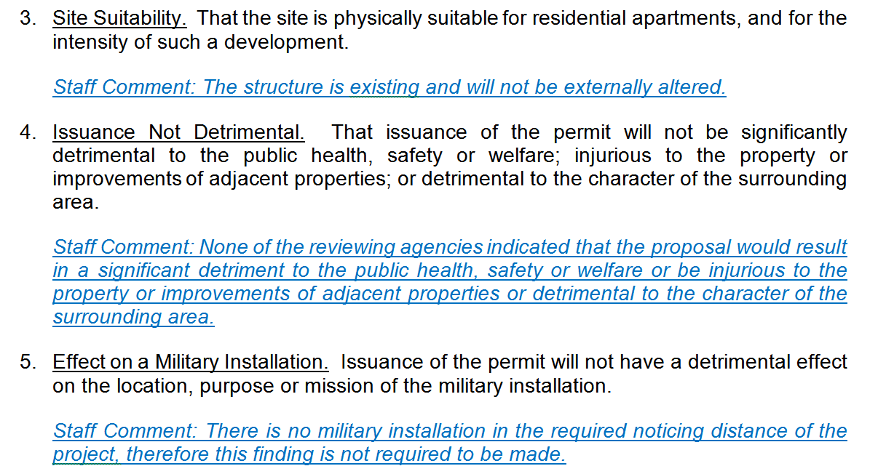
Administrative Permit Findings

Slide 12
Recommendation
Those agencies which reviewed the application recommended conditions in support of approval of the project. Therefore, after a thorough analysis and review, Administrative Permit Case Number WADMIN19-0008 is being recommended for approval with conditions. Staff offers the following motion for the Board’s consideration.

Slide 13
Possible Motion
I move that, after giving reasoned consideration to the information contained in the staff report and information received during the public hearing, the Board of Adjustment approve Administrative Permit Case Number WADMIN19-0008 for Tim Carlson, having made all four required findings in accordance with Washoe County Development Code Section 110.808.25

Slide 14
Questions?

